Slide 1

Université de Mostaganem — Dr. Madani BELACEL
TIC COURSE 01
Introduction to Information and Communication Technology
Dr. BELACEL Madani
Année universitaire 2026-2027 / Academic Year 2026-2027
Université de Mostaganem - Département Mathématiques et Informatique

Slide 2
Université de Mostaganem — Dr. Madani BELACEL
Course Outline
▪ 1. Definition of ICT
▪ 2. History and Evolution
▪ 3. Components of ICT
▪ 4. Impact of ICT on Society
▪ 5. ICT in Education
▪ 6. Digital Basics: Key Concepts
▪ 7. Outlook and Trends

Slide 3
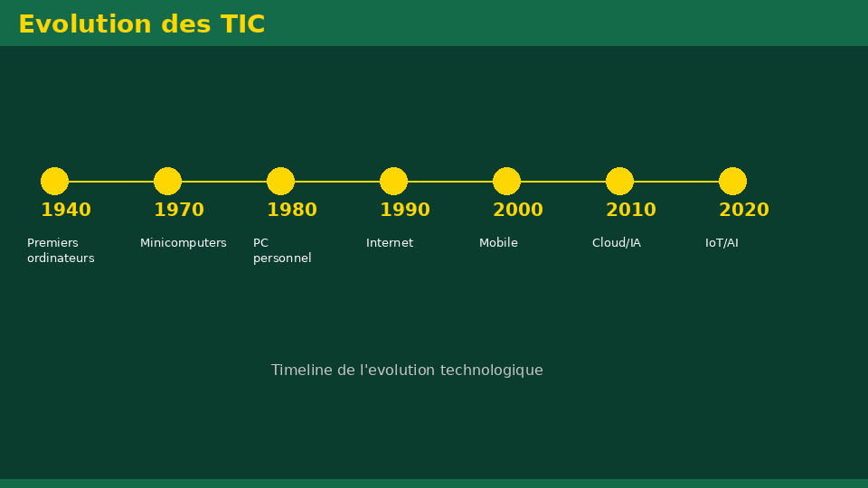
Université de Mostaganem — Dr. Madani BELACEL
Section 1
Definition of ICT

Slide 4
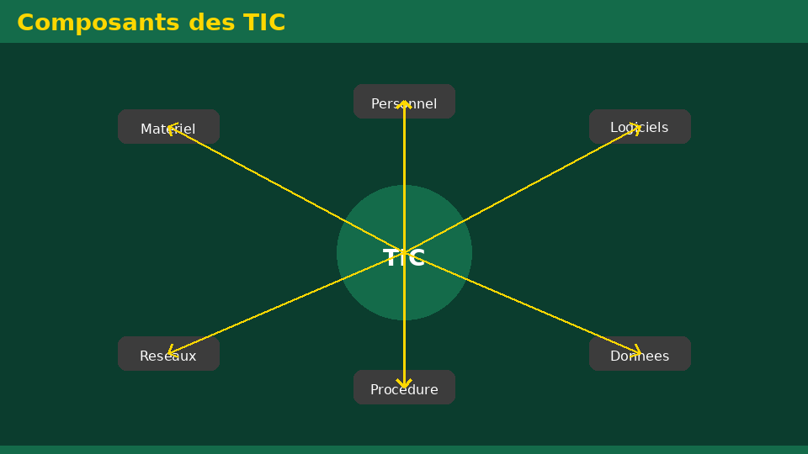
Université de Mostaganem — Dr. Madani BELACEL
1 - Definition of ICT
▪ ICT = the set of technologies used to process and transmit information.
▪ Includes: computing, electronics, telecommunications and networks.
▪ Tools: computers, smartphones, the Internet, software and applications.
▪ Goal: collect, process, store and distribute information.

Slide 5
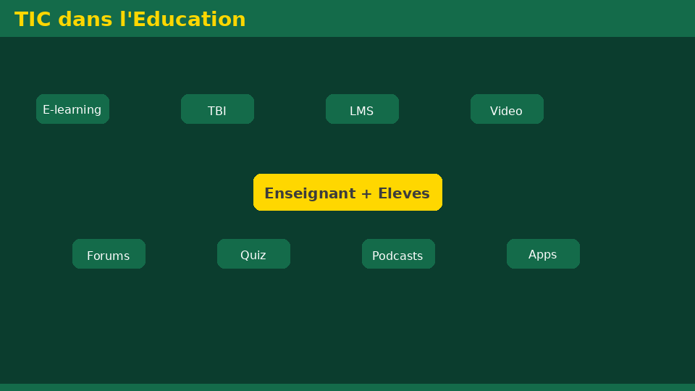
Université de Mostaganem — Dr. Madani BELACEL
Section 2
History and Evolution

Slide 6
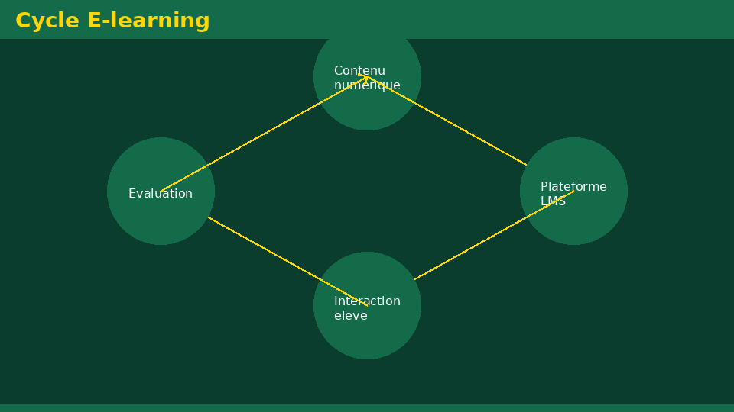
Université de Mostaganem — Dr. Madani BELACEL
2 - History and Evolution
▪ Writing and printing: the first information revolutions.
▪ Telegraph (1837), telephone (1876), radio and television.
▪ First electronic computer ENIAC (1946).
▪ Invention of the transistor (1947) then microprocessors (1971).
▪ Birth of the Internet (ARPANET, 1969) and the Web (1990).

Slide 7
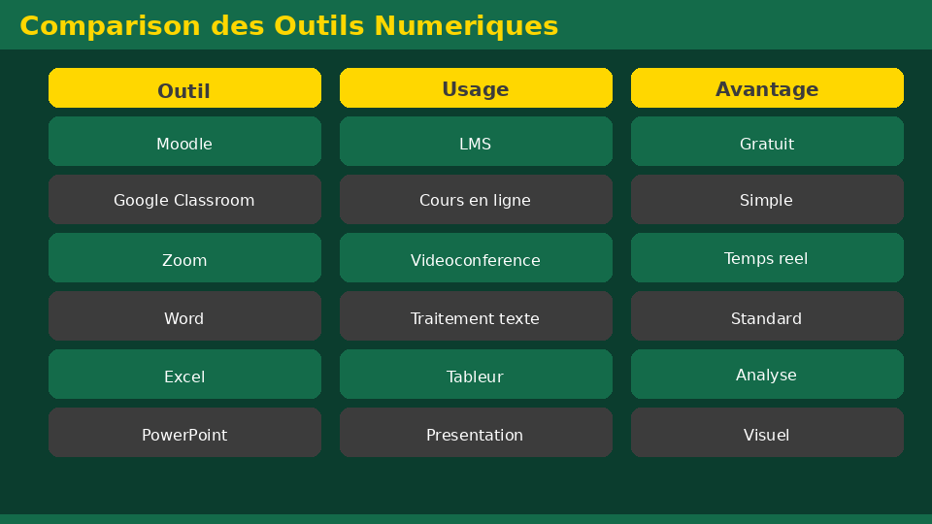
Université de Mostaganem — Dr. Madani BELACEL
Section 3
Components of ICT

Slide 8
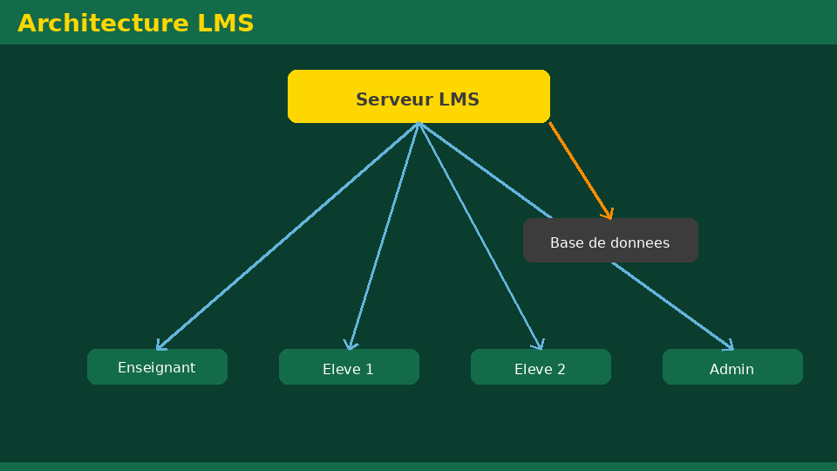
Université de Mostaganem — Dr. Madani BELACEL
3 - Components of ICT
▪ Hardware: machines and peripherals.
▪ Software: programs and operating systems.
▪ Networks: wired and wireless communication infrastructure.
▪ Data: digitized and structured information.
▪ Human resources: users and specialists.

Slide 9
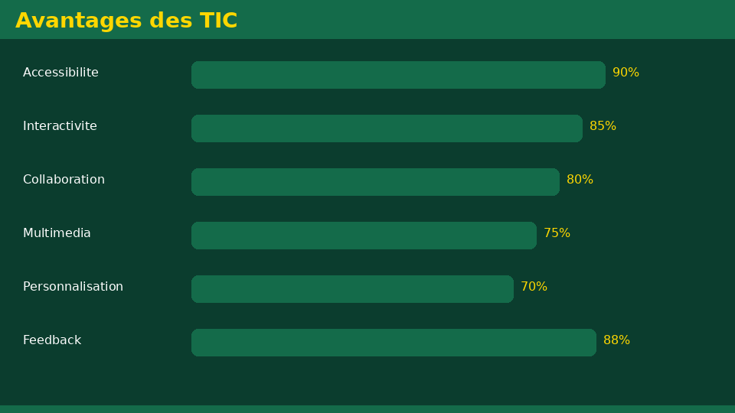
Université de Mostaganem — Dr. Madani BELACEL
Section 4
Impact of ICT on Society

Slide 10
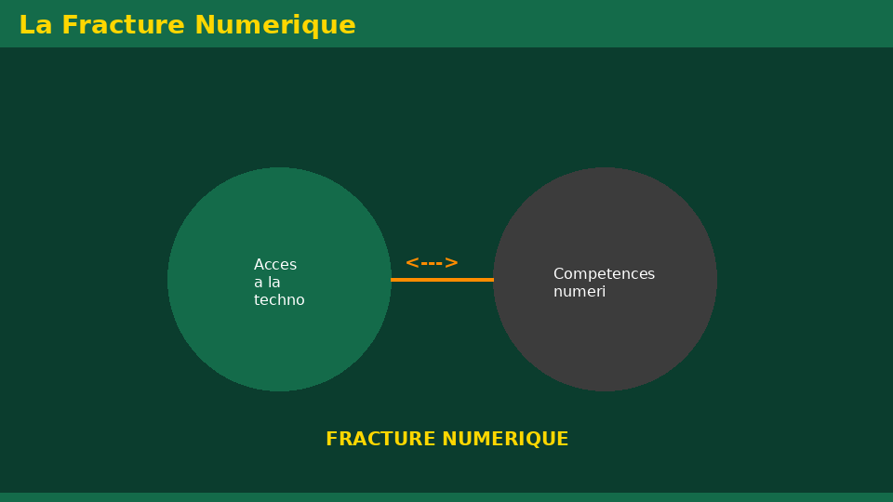
Université de Mostaganem — Dr. Madani BELACEL
4 - Impact of ICT on Society
▪ Instant worldwide communication.
▪ Access to knowledge: digital libraries, online courses (MOOCs).
▪ Transformation of work: teleworking, office automation, automation.
▪ New professions: developer, network administrator, data scientist.
▪ Challenges: digital divide, data protection, dependence.

Slide 11
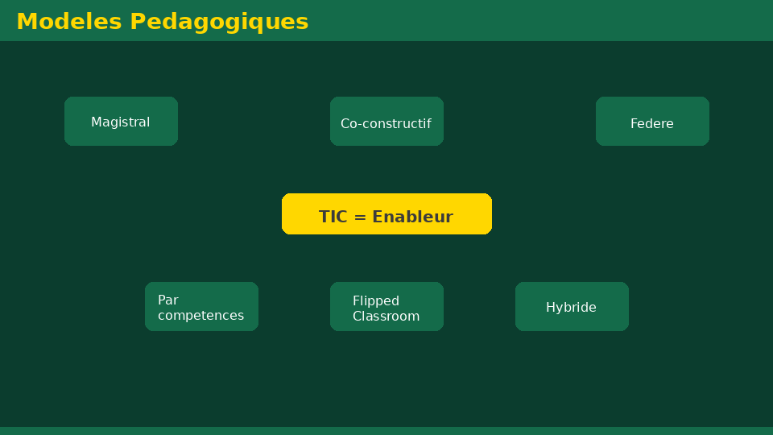
Université de Mostaganem — Dr. Madani BELACEL
Section 5
ICT in Education

Slide 12
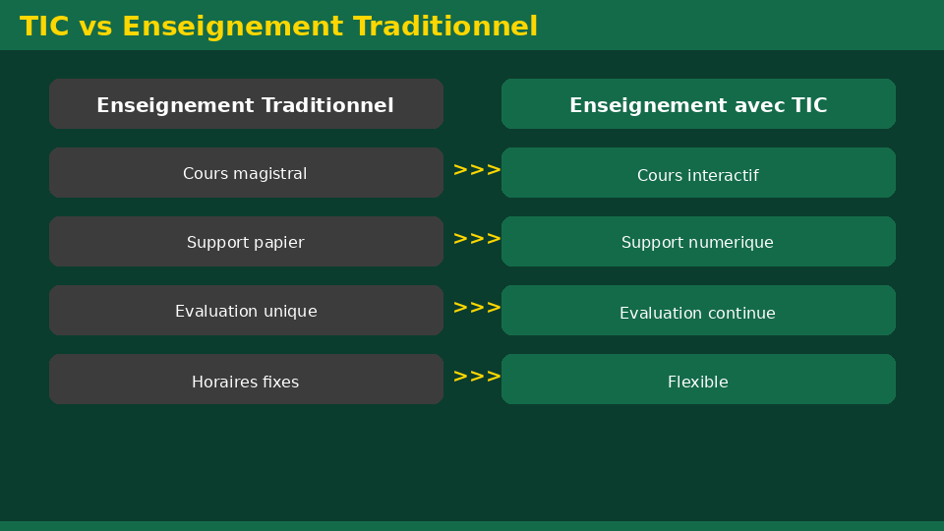
Université de Mostaganem — Dr. Madani BELACEL
5 - ICT in Education
▪ Interactive whiteboards and projectors in classrooms.
▪ E-learning platforms: Moodle, Google Classroom, Teams.
▪ Digital learning resources: videos, simulations, quizzes.
▪ Distance learning and hybrid classrooms.
▪ Individualized learning tracking through digital tools.

Slide 13
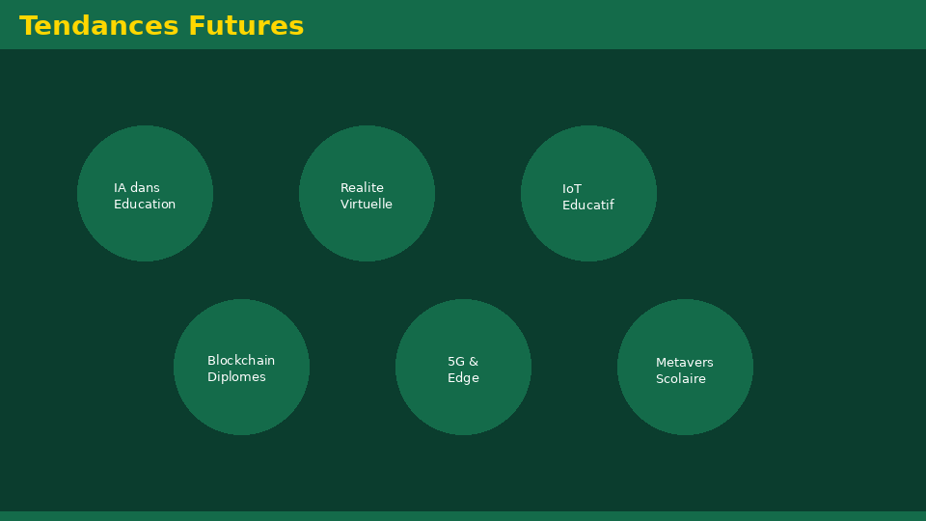
Université de Mostaganem — Dr. Madani BELACEL
Section 6
Digital Basics: Key Concepts

Slide 14
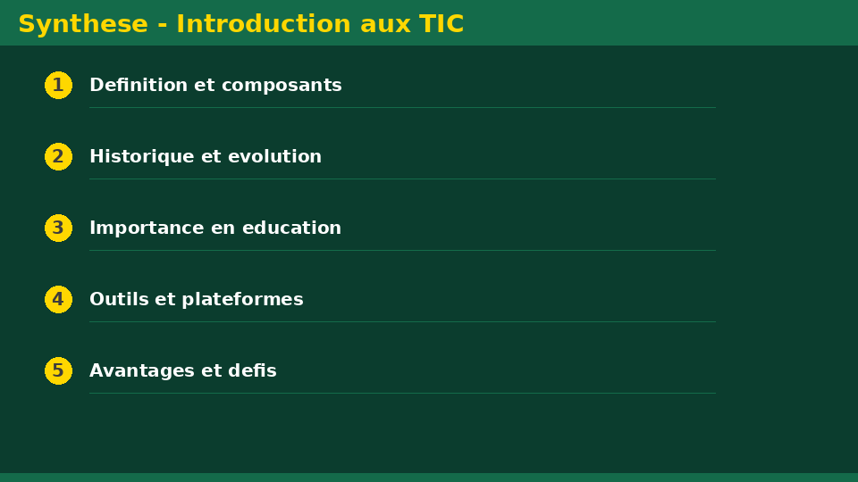
Université de Mostaganem — Dr. Madani BELACEL
6 - Digital Basics: Key Concepts
▪ Analog vs digital information.
▪ The bit (0 or 1): the elementary unit of information.
▪ Byte = 8 bits; multiples: KB, MB, GB, TB.
▪ Binary coding of all data: text, images, sound.
▪ Storage capacity and processing speed.

Slide 15
Université de Mostaganem — Dr. Madani BELACEL
Section 7
Outlook and Trends

Slide 16
Université de Mostaganem — Dr. Madani BELACEL
7 - Outlook and Trends
▪ Artificial intelligence and machine learning.
▪ Cloud computing: online storage and services.
▪ Internet of Things (IoT) and smart cities.
▪ Big data: analyzing massive datasets.
▪ Cybersecurity: a major challenge of the digital age.

Slide 17
Université de Mostaganem — Dr. Madani BELACEL
Practical Interest
▪ ICT is present in every field: health, banking, commerce, education.
▪ Mastering ICT is an essential professional skill.
▪ They save time, reduce costs and improve quality.
▪ Examples: online payment, telemedicine, e-government, e-learning.

Slide 18
Université de Mostaganem — Dr. Madani BELACEL
Self-Assessment (MCQ)
1. What does ICT stand for?
a) Industrial and Commercial Techniques
b) Information and Communication Technology
c) Computer Processing of Calculations
2. Which event marked the birth of the Internet?
a) The invention of the transistor
b) The creation of ARPANET in 1969
c) The appearance of the Web in 1990
3. A byte contains:
a) 4 bits
b) 8 bits
c) 16 bits

Slide 19
Université de Mostaganem — Dr. Madani BELACEL
Conclusion
▪ ICT combines computing, networks and telecommunications.
▪ They have deeply transformed society, work and education.
▪ Understanding their foundations is the first step toward mastering digital technology.
▪ Next course: the computer and its components.

Slide 20
Université de Mostaganem — Dr. Madani BELACEL
References
- C. Balpe et al., "Initiation to Computing", Ellipses.
- J. Baudouin, "Introduction to Information Sciences", Armand Colin.
- ICT Course materials, CS Department, University of Mostaganem.
- Official sites: www.education.dz, www.w3schools.com.

Slide 21
Université de Mostaganem — Dr. Madani BELACEL
Thank you for your attention!
Questions?
Dr. BELACEL Madani

